Slide 1
Analysis of bike sharing dataset
Satyaki Ray

Slide 2
Initial data exploration
Q1a Total number of bike stations:70
select count(*) from station;
Q1b-total number of bikes:700
select count(distinct(bike_id)) from trip2;
Total number of trips:669959
select count(*) from trip2;

Slide 3

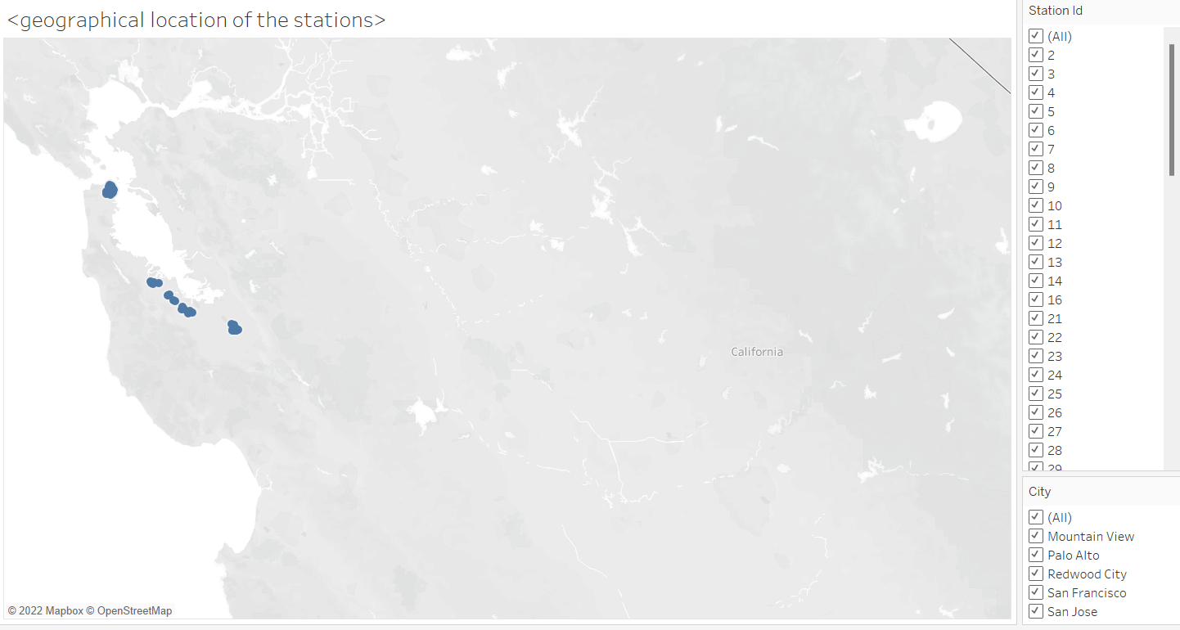
Geographical location of the stations

Slide 4
Relationship between different variables
Bike_id to start_station_id (trip table): One to many
select bike_id, count(distinct(start_station_id)) from trip2 group by bike_id order by bike_id;
Pin code(weather) and station_location(station): No relation since latitude and longitude associated with each pincode is not available
2013-08-29 and mean_wind_speed_mph: one to many
select mean_wind_speed_mph from weather where date='2013-08-29';

Slide 5
First and Last trip data
First trip data:
select * from trip2 order by start_date limit 1;
Last trip data:
select * from trip2 order by start_date desc limit 1;

Slide 6
Average duration
Average duration of all trips :1107.94 s
select avg(duration) from trip2;
Average duration of trips where starting and ending stations are same:6357 s
select avg(duration) from trip2 where start_station_id=end_station_id;

Slide 7
Most used bike
select bike_id,sum(duration) n_dur from trip2 group by bike_id order by n_dur desc;
Most used bike :535

Slide 8
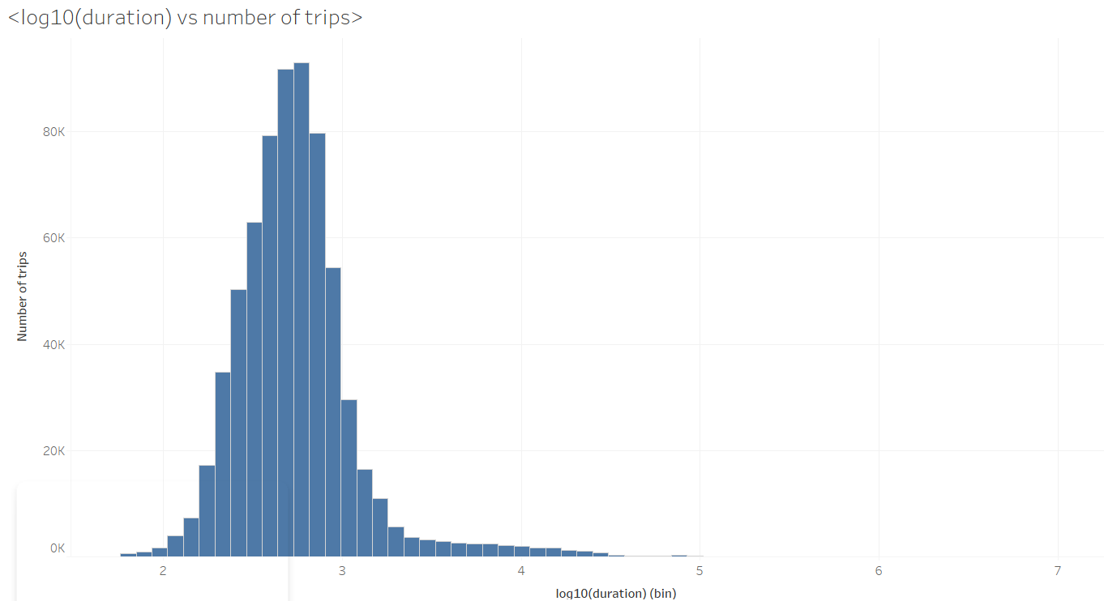
Log10(duration) vs number of trips

Slide 9
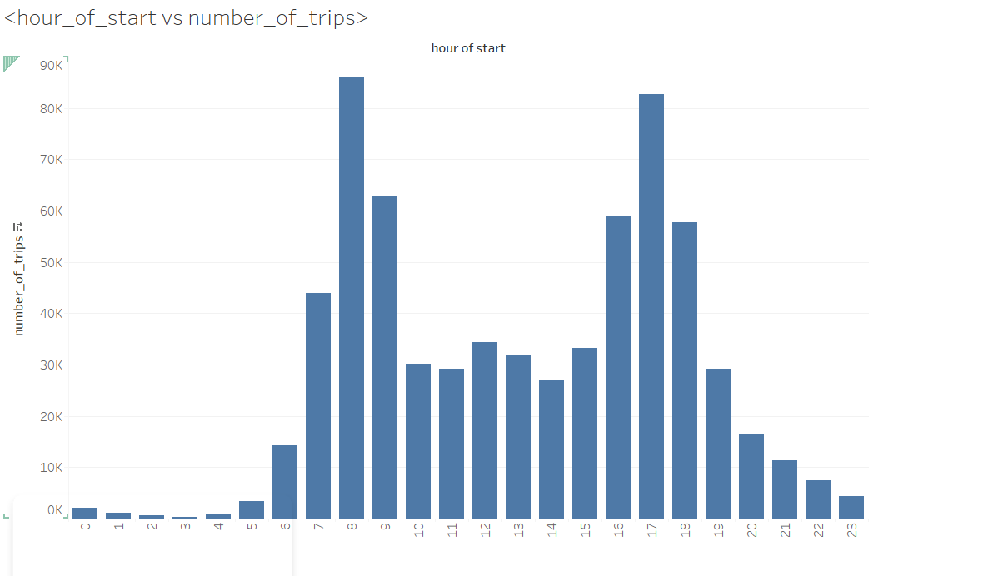
hour of starting vs number of trips

Slide 10
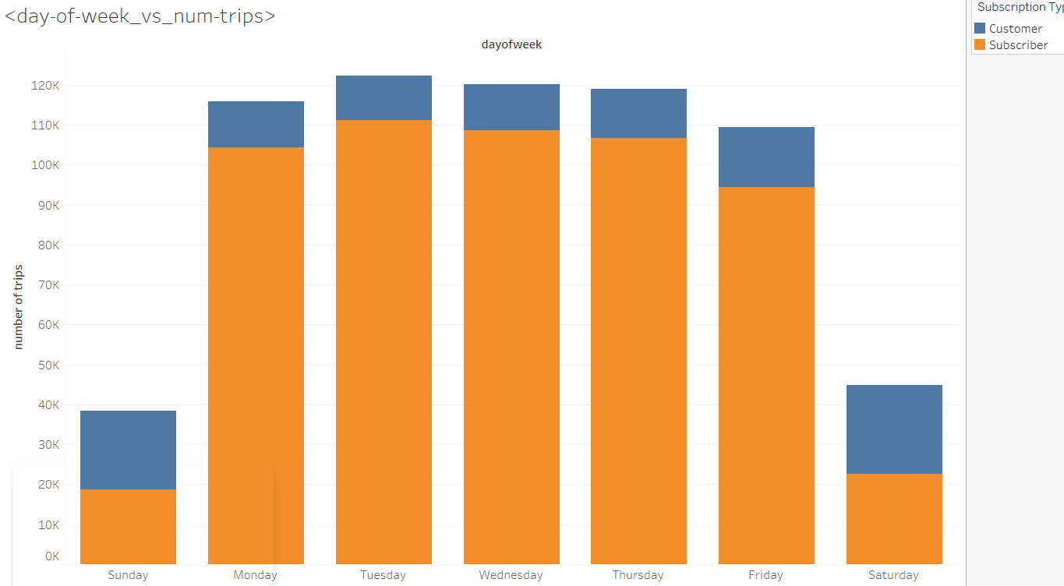
Day-of-week_vs_number-of-trips

Slide 11

Task 2 : Demand Prediction

Slide 12
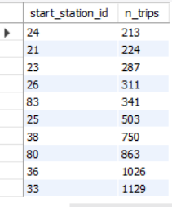
10 least popular stations
select start_station_id,count(*) n_trips from trip2 group by start_station_id order by n_trips limit 10;

Slide 13
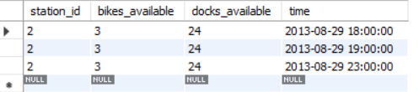
Idle time for station2
select * from status
where station_id=2 and bikes_available>=3
and time>='2013-08-29' and time<'2013-08-30';
Idle time=23:00-18:00= 5 hours

Slide 14
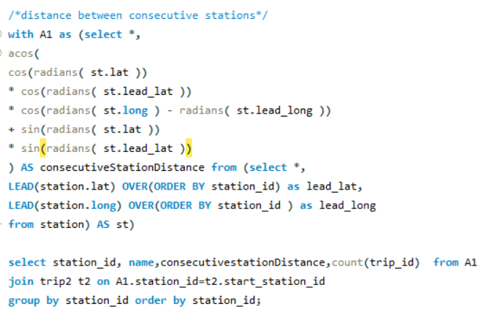
Stations that can be closed
21,23,24 can be closed

Slide 15
Task 3: Optimizing operations

Slide 16
Average number of bikes and docks for station 2
Average number of bikes: 10.83
Average number of docks: 16.17
select avg(bikes_available) avg_bikes, avg(docks_available) avg_docks from status where station_id=2;

Slide 17
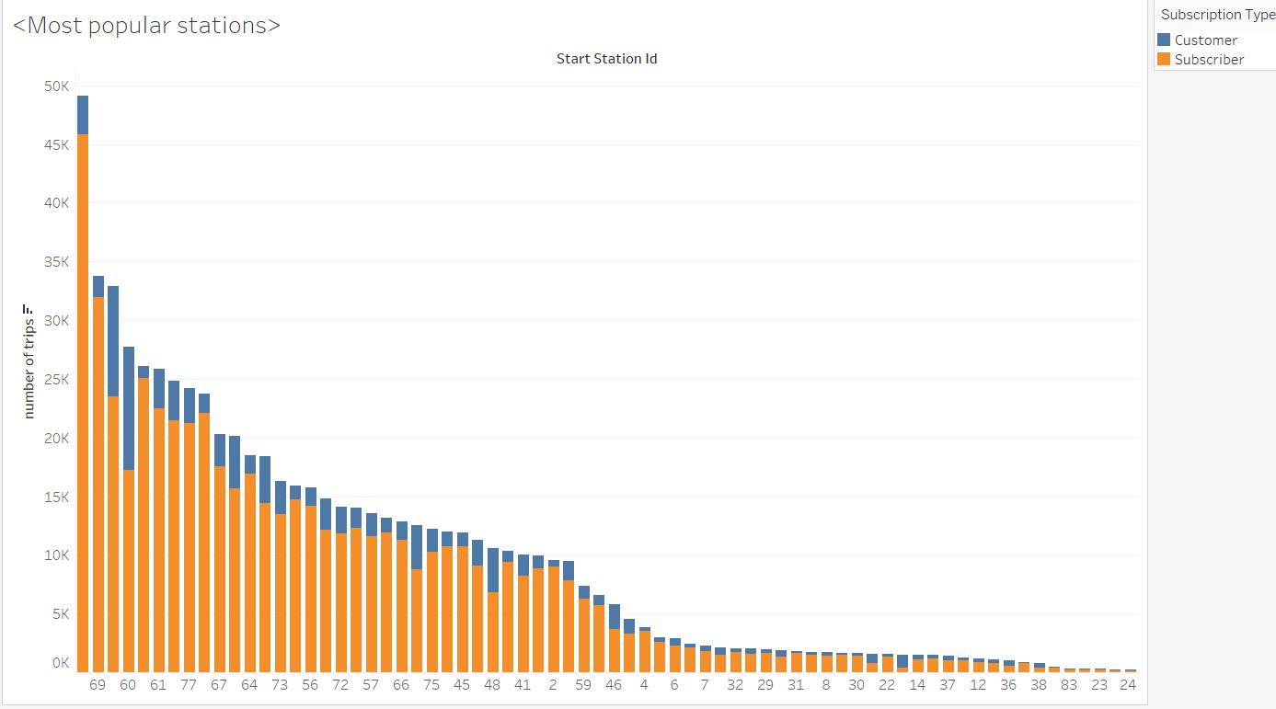
Most popular stations by subscribers and customers

Slide 18
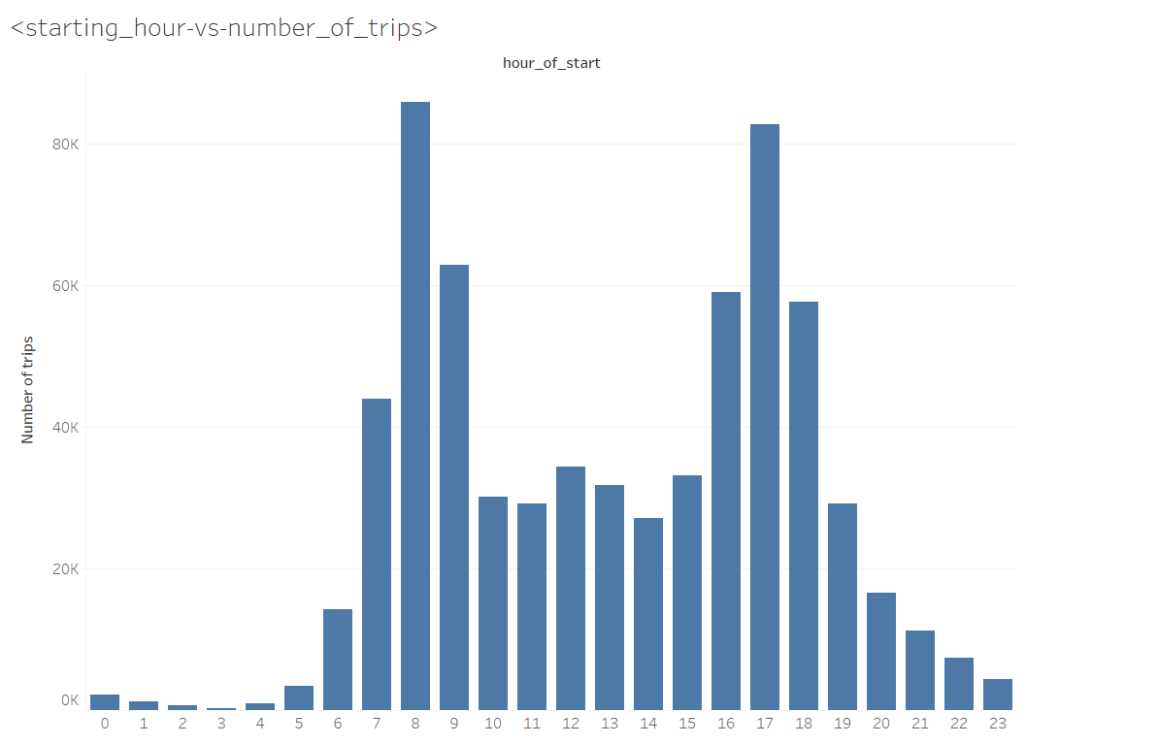
Starting_hour -vs- number_of_trips

Slide 19
Optimizing operations
Ensuring availability of bikes at the most popular stations
Ensuring availability of bikes during peak demand hours

Slide 20
Task 4: Couple bikes

Slide 21
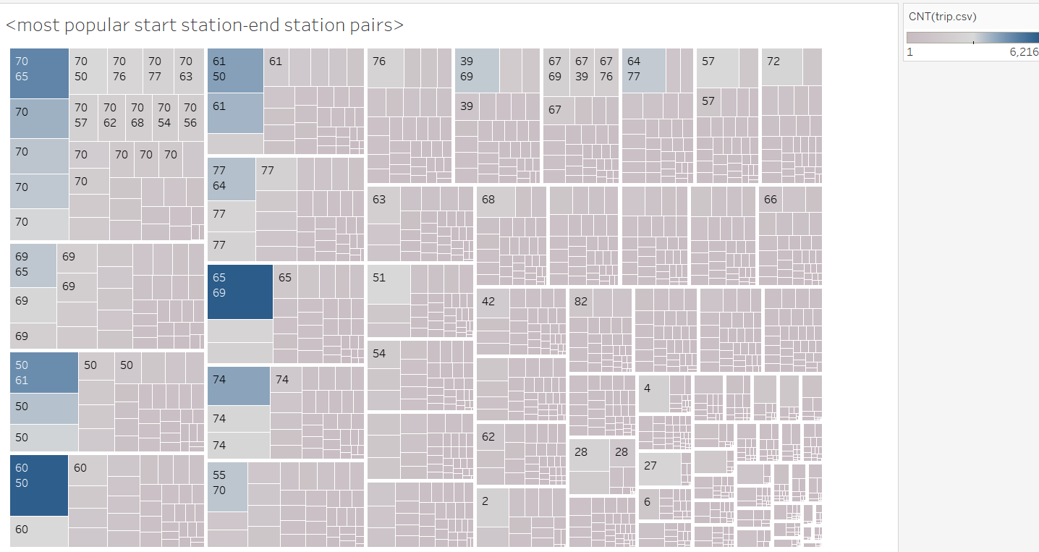
Factors to be considered
Most popular start-end station pairs need to be identified
Small number of couple bikes need to be introduced at these stations
Number of couple bikes to be adjusted based on usage statistics

Slide 22
Additional information
Link to dashboard :
https://public.tableau.com/app/profile/satyaki8517/viz/Bike-sharing_16462509442360/Dashboard1?publish=yes

